Slide 1
Let’s Keep Talking about Collecting Narrative Games in Libraries
Colin Post
Dept. of Information, Library, and Research Sciences
University of North Carolina - Greensboro

Slide 2
Greetings from library world! I’m here because I think digital games should be in libraries!

Slide 3
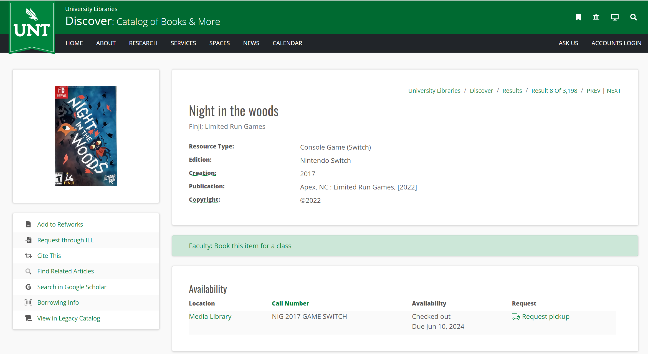

Slide 4
Libraries cannot currently collect and provide access to digitally-distributed games…or at least not in a legally sound way.

Slide 5
Libraries have found ways to collect other kinds of digital resources, though not without issues.

Slide 6
If libraries want to keep collecting and providing access to games…
They’ll need to develop new models and approaches
They can learn from what’s worked (and what hasn’t) from ebooks and digital video
They’ll need to include game developers and publishers in those conversations

Slide 7
What I’ve done since last year’s NarraScope…
Talked with people in the library world
Talked with people in the interactive fiction world
Surveyed game developers more broadly

Slide 8
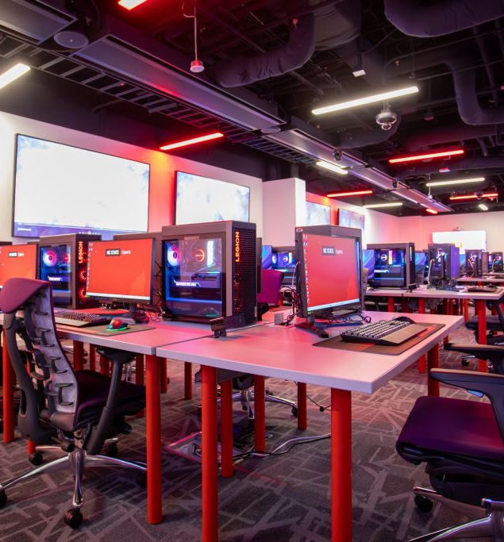
Engaging libraries
Identified 33 US academic libraries demonstrating some outward interest in providing access to digital games
Librarians at 13 institutions participated in research interviews
Interviews covered some key considerations for digital game licenses
Gaming and Esports lab at North Carolina State University
https://www.lib.ncsu.edu/spaces/gaming-esports-lab

Slide 9
Engaging IF folks
Following my presentation at NarraScope last year, I held focus groups open to anyone from the IF community
6 people participated across two focus group sessions
Covered similar questions as library interviews, but focusing on IF author perspective
A summary of those conversations was shared on IntFiction for further discussion
https://intfiction.org/t/lets-talk-about-collecting-narrative-games-in-libraries/

Slide 10
Engaging game developers more broadly
Distributed a survey to the membership of the International Game Developers Association (IGDA)
Survey was open February-March 2024
Posed similar questions as focus group sessions
34 people started the survey, with 23 complete responses
https://igda.org/

Slide 11
Overall, both libraries and game developers want to see games in libraries and largely align on the why and the how.

Slide 12
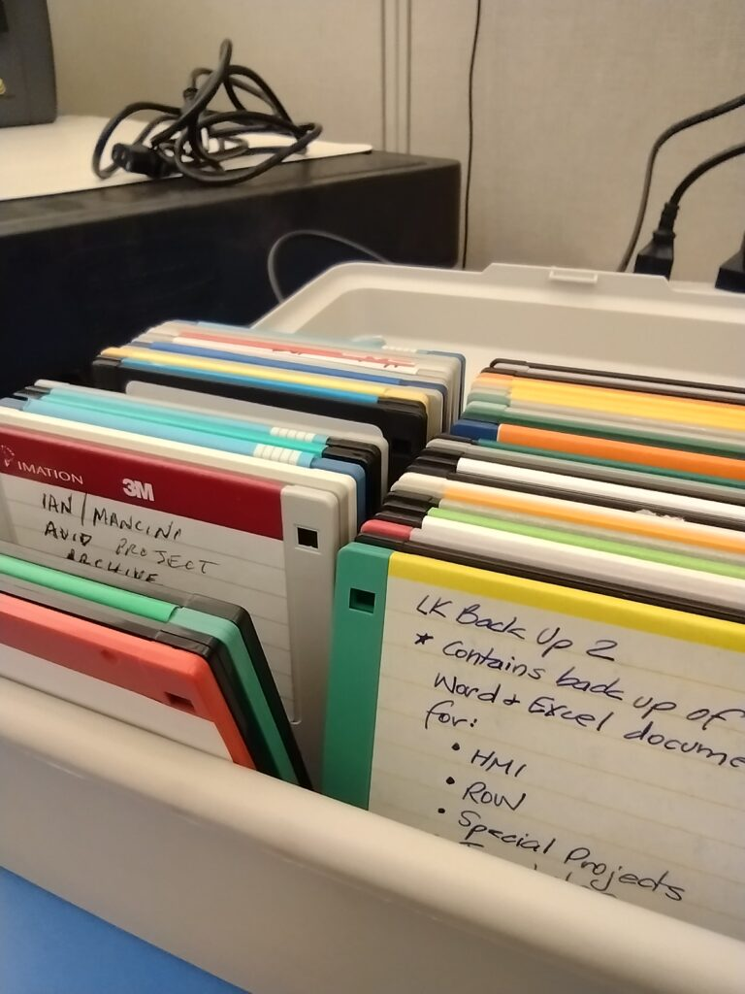
What would the library actually collect?
Nearly all libraries would prefer to license access through an external platform
Game developers largely open to either working with an external platform or providing library with game files
Both libraries and developers express concerns about longevity and sustainability of external platforms
Floppy disks at the Library of Congress,
https://blogs.loc.gov/preservation/2021/08/kilobytes-of-cultural-heritage-preserving-collections-on-floppy-disks/

Slide 13
“My concern with a third party is the third party is not guaranteed not to be commercial. Some of those third parties that provide content to those libraries are for-profit models, whereas a library ostensibly, usually but not always, is not a for-profit model. I'd be more comfortable with those files being stored there. But then again, I'm also aware that that may not be practical for every single library to have its own server, quite frankly. So, I think that's kind of a sticky question.”
IF author in focus group session, July 2023

Slide 14
How would library users access and use the games?
Librarians would focus collection development efforts on games used to support teaching and research
But these collections would ideally also be used for FUN
Nearly all game developers were fine with games in libraries being played for any purpose
Different considerations would apply for public libraries (e.g. content warnings or age restrictions)

Slide 16
“Given 35,000 undergraduates at [our school], we tend to go for unlimited as much as possible just because you never know how many people need to access a work at one time.”
Librarian interview, June 2023

Slide 18
“Yeah, I feel like the library is just another access point. For free games, we understand that when it's available, the whole internet could play it at once.”
IF author in focus group session, July 2023

Slide 19
“I could imagine some authors maybe not wanting all of their material presented sort of flat without any overriding context.
With books, they have gone through a publishing cycle; with self-published works, the time and the context in which it was written is actually quite important.
So that might be a case where this material should be handled with a little more care than typical digital materials, especially that go through vendors.”
IF author in focus group session, July 2023

Slide 20
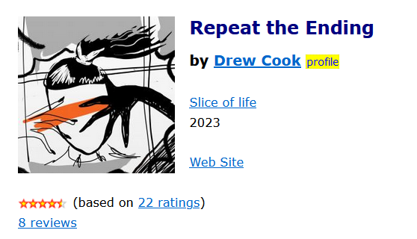
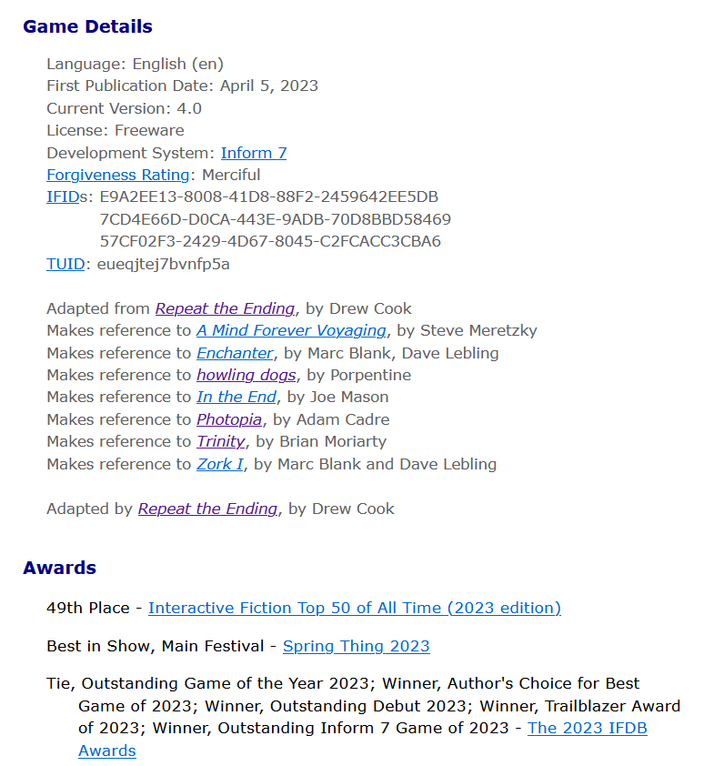
What else would libraries need to do to manage game collections?
Representing games in library catalogs would be essential
But unsure how some metadata particular to games would translate to library catalogs

Slide 21
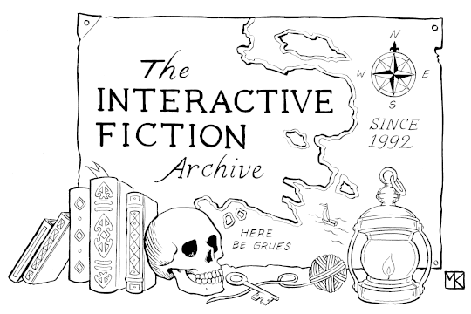
Big questions remain about who would be responsible for long-term preservation of digital games…

Slide 22
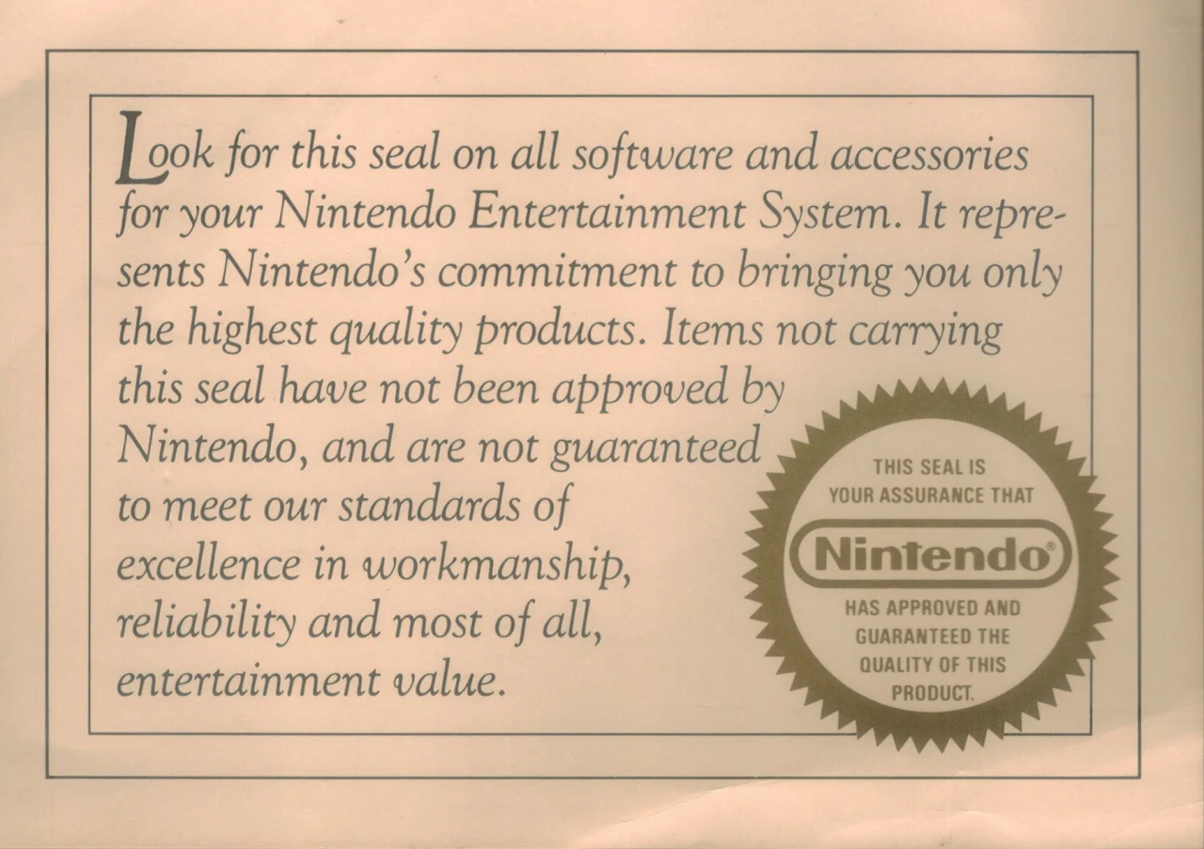
What obligations would libraries and developers have to each other?
Libraries are interested in the same manner of services and support afforded to individual consumers (patches, basic troubleshooting)
Both libraries and developers recognize the logistical challenges of providing ongoing support outside of some Steam-like platform
Looking for a seal of approval,
https://www.nintendolife.com/news/2019/02/talking_point_what_does_the_nintendo_seal_of_quality_mean_in_2019

Slide 23
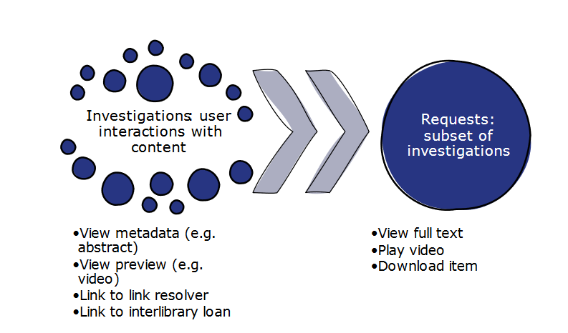
Both libraries and developers would be interested in getting usage statistics for games in library collections, but this is another area that would be much easier to manage through some external platform.
Illustration for COUNTER, the standard metrics integrated into other kinds of electronic resource platforms for libraries
https://www.countermetrics.org/wp-content/uploads/2024/04/Guide-Metrics.pdf

Slide 24
How much would libraries pay for games?
Libraries recognize that pricing will depend on…
Number of simultaneous users
How games are being made accessible
Other rights afforded to libraries in license
Libraries are interested in a range of possible acquisition models and pricing structures
One-time purchase for single seat
User-driven acquisition
Subscription model
Requesting UNCG add Computer Chess via Kanopy

Slide 26
“There are places, particularly the Internet Archive, where stuff is uploaded on behalf of other creators all the time. Sometimes, things of mine have been uploaded there and I only found it by accident. [With games] I think we do have a culture of people discovering materials and wanting to make it available and the author is often not in the loop there.”
IF author in focus group session, July 2023

Slide 27
Open questions and challenges
An external platform making games available to libraries would be the best solution for most use cases
But this either needs to be built, or…
Some existing platform needs to be adapted for libraries
Libraries are still trying to figure out how to preserve games on physical media
What role should libraries play in preserving digital games?

Slide 28
What now?
We need to broaden the conversation
Include more librarians, and especially public librarians
Include more game developers, and especially a broader swathe of the indie gaming community
Bring librarians and game developers together
We need to pilot different licensing frameworks and access models and build from there

Slide 29
Thanks! I’ll be happy to answer any questions now. Or email me at ccpost@uncg.edu.

